Slide 1

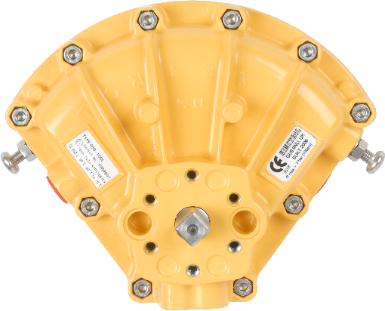
KINETROL

Slide 2
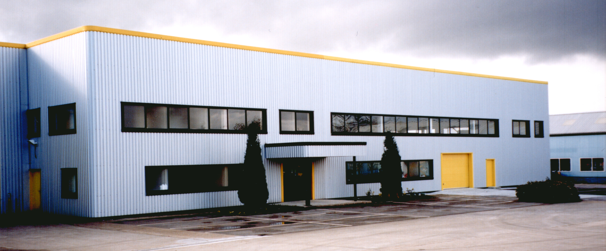


The Kinetrol Advantage
• Privately owned for over 50 years
• Manufactured in three sites in Farnham, England.
• All parts (actuators and accessories) are engineered and made in-house to guarantee quality.
+44 (0) 1252 733838
kinetrol.com

Slide 3
What makes Kinetrol different?
Kinetrol is not a “lunch box” actuator
Think Outside the Box
Niche applications
Problem solver
Different shape
+44 (0) 1252 733838
kinetrol.com

Slide 4
Unique Features
Single Moving Part
Most reliable mechanism for 1/4 turn actuation
Double Opposed Polyurethane Lip Seals
Pressure assisted for long life (no “O” rings)
Compact and Efficient
Best torque/size package available, fastest operating speeds and lowest air consumption
Constant Output Torque
Kinetrol matches the torque output of metal seated ball valves throughout the entire stroke
One Piece Shaft and Vane
Zero hysteresis for V-ball control applications
+44 (0) 1252 733838
kinetrol.com

Slide 5
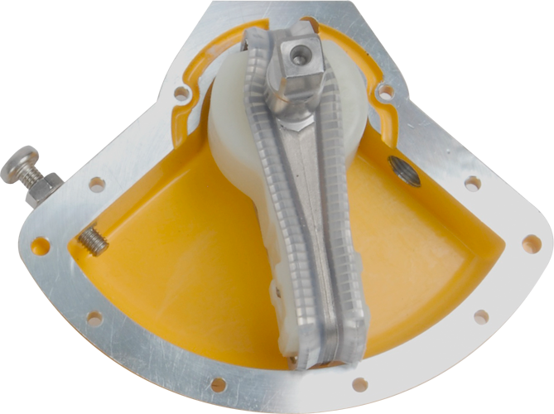
Most Suited Applications
High Cycle
High Temperature
Quick Opening/Closing
Metal Seated Ball Valves
Control Applications (V-Ball Valves)
Space Constraints
+44 (0) 1252 733838
kinetrol.com

Slide 6
High Cycle Applications
Kinetrol actuators are guaranteed to 4,000,000 cycles because they last
Typical Applications are:
• Bottle filling
• Injection mold cooling
• Batch processes
+44 (0) 1252 733838
kinetrol.com

Slide 7
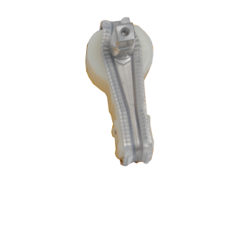
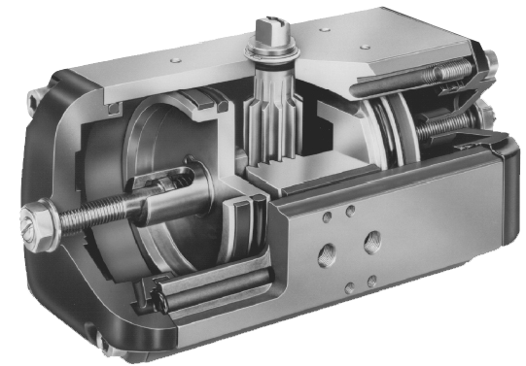
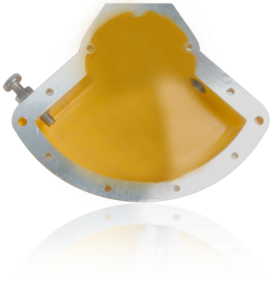



Fast Open/Close Times
Internally, Kinetrol actuators have almost no "Dead space”
Internally, Rack & Pinion actuators have lots of “Dead space”
“Dead space"
The majority of the plant air supply is being used to move the vane, rather than fill in dead space.
That’s why Kinetrol’s have such fast open/close times
“Dead space"
+44 (0) 1252 733838
kinetrol.com

Slide 8
Compare “Dead Space” to see why Kinetrol actuators operate faster
KINETROL
COMPETITION
“Dead space"
Smaller “Dead space” = faster open/close times
“Dead space"
+44 (0) 1252 733838
kinetrol.com

Slide 9
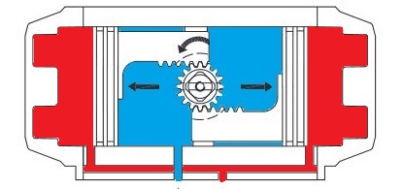
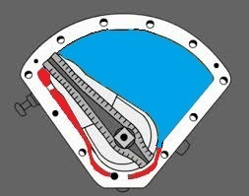
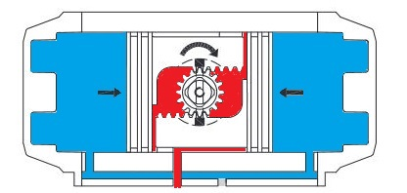
Cost of Operation
Comparing a Kinetrol to a typical Rack & Pinion actuator ”Dead Space” = ”Cost”
“Dead space”
(In Red)
Kinetrol – The vane design has built up sideplates to keep dead volume to a minimum
How do we quantify this volumetric efficiency?
Rack & Pinion – Considerably greater dead volume: More air per stroke = less efficiency
+44 (0) 1252 733838
kinetrol.com

Slide 10
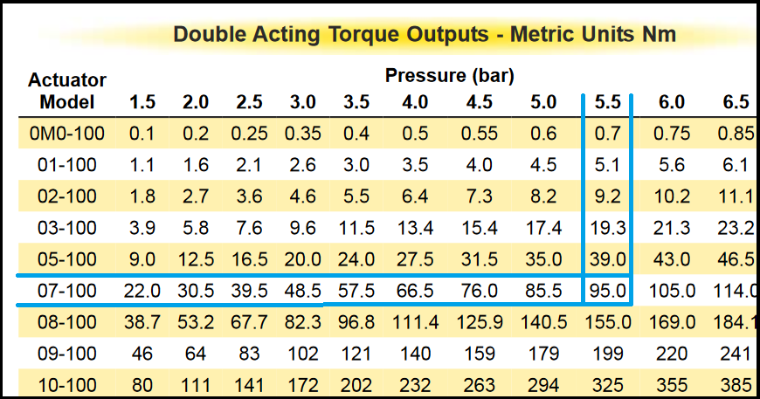
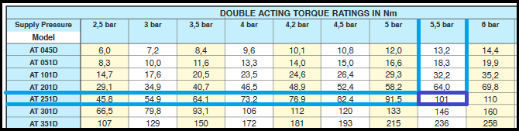
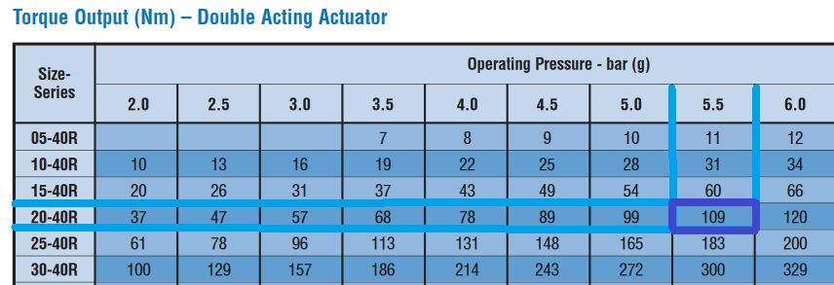
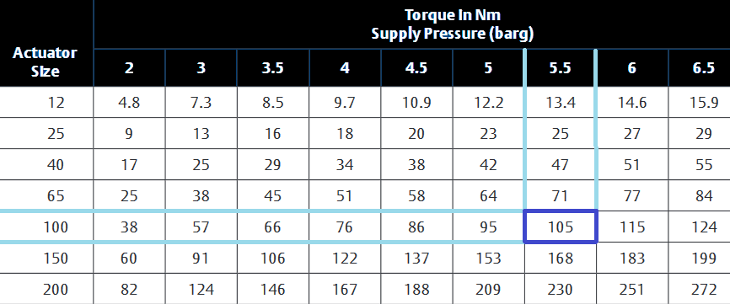
Cost of Operation
(Double Acting Actuator Comparison)
Air Torque - Model AT251D
- 101 Nm @ 5.5 bar
Kinetrol - Model 07
- 95 Nm @ 5.5 bar
Flowserve Norbro - Model 20-40R
- 109 Nm @ 5.5 bar
El-O-Matic - Model FD100
- 105 Nm @ 5.5 bar
+44 (0) 1252 733838
kinetrol.com

Slide 11
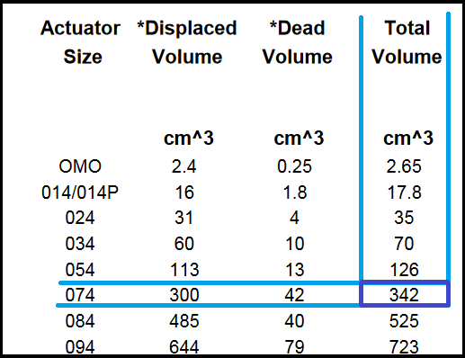
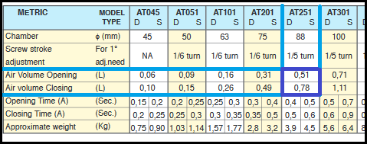
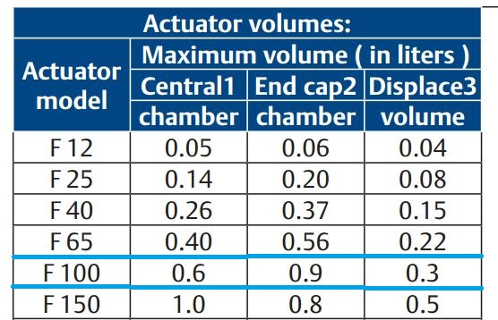
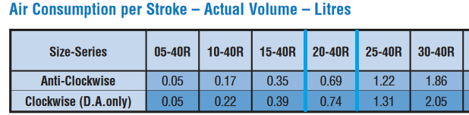
Cost of Operation
(Air/Energy Consumption Comparison)
Kinetrol - Total volume per cycle: (0.342 x 2) = 0.684 litres
Air Torque - Total volume for one complete cycle: (0.51 + 0.78) = 1.29 litres
Flowserve - Total volume per cycle: (0.69 + 0.74) = 1.43 litres
El-O-Matic -Total volume per cycle: (0.6 + 0.3) + (0.9 + 0.3) = 2.1 litres
+44 (0) 1252 733838
kinetrol.com

Slide 12
Cost of Operation
(Air/Energy Consumption Comparison)
Air Torque - (1.29L/0.684L) x (95Nm/101Nm) = 1.77
Flowserve Norbro - ( 1.43L/0.684L) x (95Nm/109Nm) = 1.82
El-O-Matic - (2.1L/0.684L) x (95Nm/105Nm) = 2.77
The torque specific (L/Nm) energy consumption of these actuators are 1.77, 1.82 or 2.77 times that of the equivalent Kinetrol actuator
+44 (0) 1252 733838
kinetrol.com

Slide 13
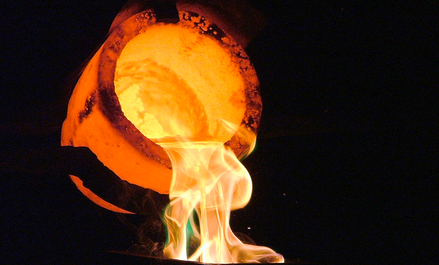
High Temperature Applications
Kinetrol can be installed with Viton seals for high ambient temperatures.
Examples of high ambient applications are:
• Beside Boilers
• Beside Furnaces
• Installed on high temperature valves
+44 (0) 1252 733838
kinetrol.com

Slide 14
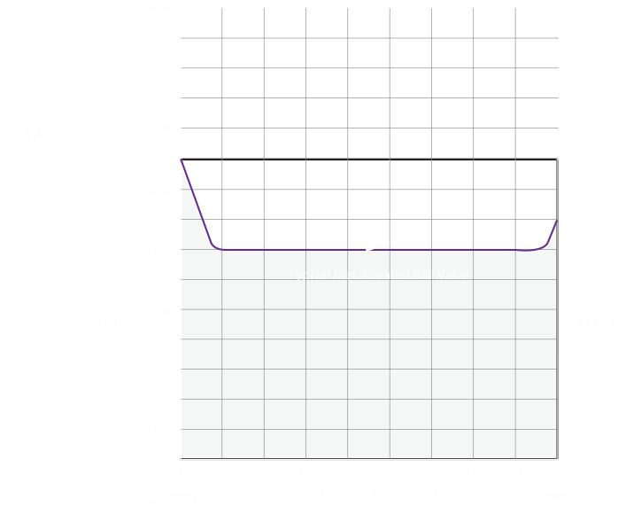
Sizing Actuators – Kinetrol
Kinetrol Actuator torque matches the valve perfectly
Typical Kinetrol Torque
+44 (0) 1252 733838
kinetrol.com

Slide 15
Sizing Actuators - Rack & Pinion
End of stroke torque of Rack & Pinion isn’t enough to close the valve
Typical Torque for a Rack & Pinion Actuator
+44 (0) 1252 733838
kinetrol.com

Slide 16
Sizing Actuators – Scotch Yoke
Danger zone: Valve shaft will break
MAST (Maximum Allowable Shaft Torque)
Problem: Actuator torque is too much for the valve shaft
Solution: Use a larger actuator
Run torque of Scotch Yoke actuator isn’t enough to close the valve
Larger Symmetrical Yoke Actuator Torque Curve
Typical Symmetrical Yoke Actuator Torque Curve
+44 (0) 1252 733838
kinetrol.com

Slide 17
Sizing Actuators
• Valve manufacturers design the shafts to be as efficient as possible
• All shafts have a “MAST” (Maximum allowable shaft torque)
• When the actuator torque exceeds the MAST, the shaft will break
+44 (0) 1252 733838
kinetrol.com

Slide 18
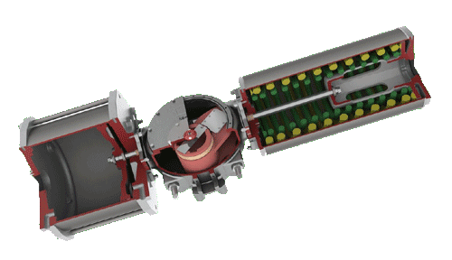

Rotary Control Applications (V-Ball Valves)
Kinetrol
Rack & Pinion, and Scotch Yoke Actuators
With Kinetrol’s direct mount positioner and anti-backlash coupling, any movement from the positioner results in an identical movement in the valve
Precise, Pin Point Accuracy
Rack and pinion’s wear out and become “sloppy”
Scotch Yoke’s wear out and become “sloppy”
Change Linear Motion
To Rotary
Uses rotary motion to operate rotary valves
Both quickly start to get hysteresis, which means you don’t control your process well
aaaaaa
+44 (0) 1252 733838
kinetrol.com

Slide 19
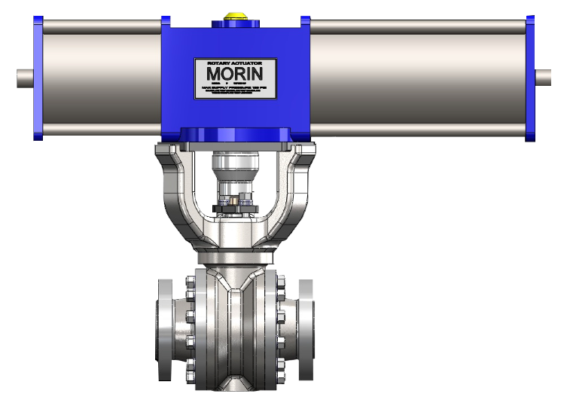
Space Constraints
Scotch Yoke/Rack & Pinion
(Short and Fat)
Kinetrol Actuators
(Tall and skinny)
Think Outside the Box
Kinetrol’s are a different shape than other actuators
They often fit in places where scotch yoke, and rack & pinion actuators can’t
+44 (0) 1252 733838
kinetrol.com
Notes:
Position 1 - Horizontal pipeline, vertical stem:
In this orientation, a bracket is acceptable
Position 2 - 45 degree pipeline, vertical stem:
In this orientation, a bracket is not acceptable. The bracket will bend and create side-loading on the actuator because it is weak. A bracket is not recommended because you want to be able to use the valve/actuator in any orientation.
Position 3 - Vertical pipeline, horizontal stem:
In this orientation, a bracket is not acceptable. The bracket will bend and create side-loading on the actuator because it is weak. A bracket is not recommended because you want to be able to use the valve/actuator in any orientation.
Position 4 - Horizontal pipeline, horizontal stem:
In this orientation, a bracket is not acceptable. The bracket will bend and create side-loading on the actuator because it is weak. A bracket is not recommended because you want to be able to use the valve/actuator in any orientation.

Slide 20
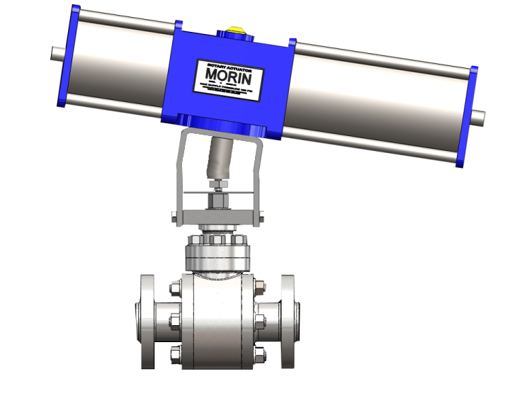
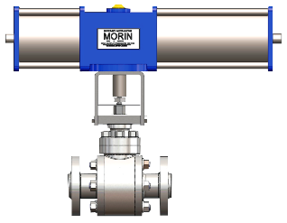
Side-loading
Scotch yoke actuators are not symmetrical
Side-loading causes packing leaks which lead to premature failure of the valve
+44 (0) 1252 733838
kinetrol.com

Slide 21
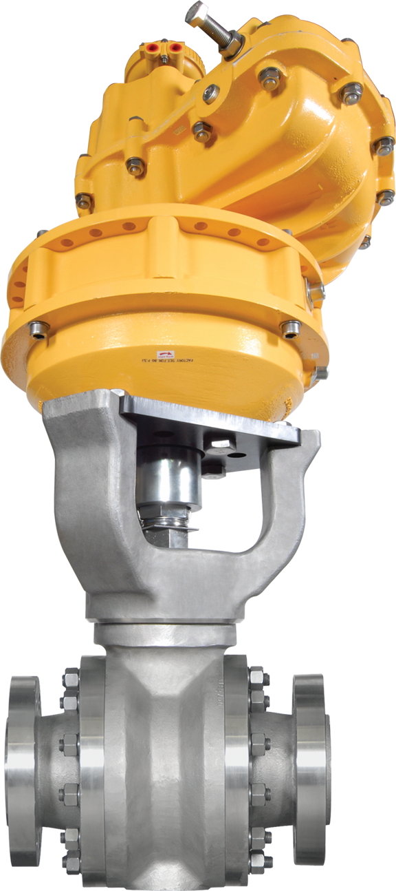

The Kinetrol Advantage
Kinetrol’s aren’t a typical “lunch box” type actuator, SO
Think Outside the Box
And use them in applications where rack & pinion or scotch yoke actuators don’t perform
+44 (0) 1252 733838
kinetrol.com

